Slide 1
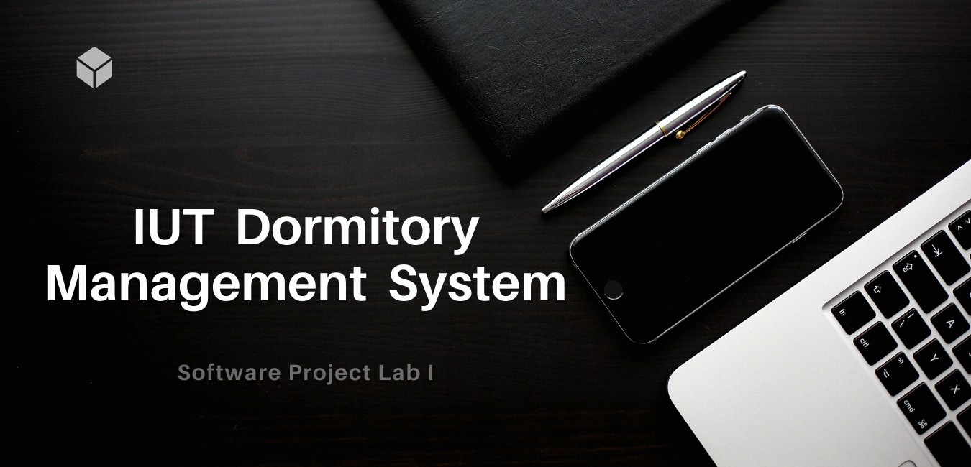
1

Slide 2
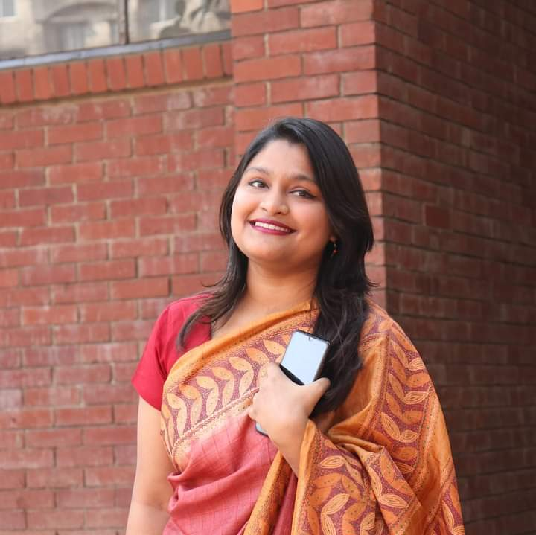

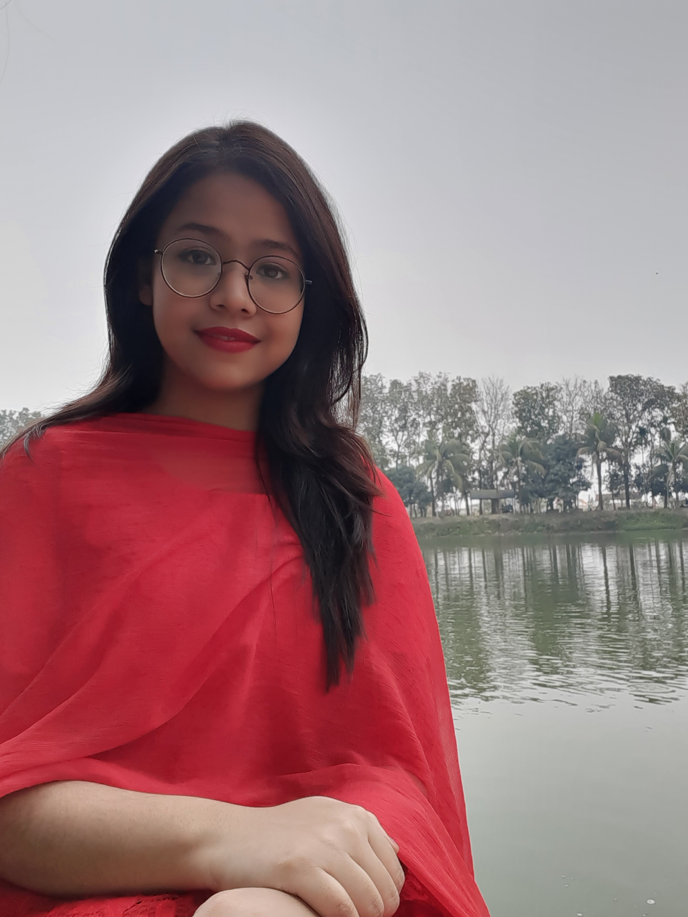
Meet The Team!
Nafisa Tabassum
190042104
Ajwad Abrar
190042106
Prianka Maheru
190042112
2

Slide 3
TABLE OF CONTENTS
Project Overview
01
04
Technologies
Project Motivation
02
Challenges
05
Major Features
03
Project Timeline
06
A short overview of the project
Technologies we are using
Motivation behind the project
Challenges we are facing
Core features of the project
Timeline of the project
3

Slide 4
Project Overview: What is IUT DMS?
IUT DMS is basically a web based application for maintaining the dormitory system digitally.
Every year many students get into IUT & start staying in the hall, get notified about hall notices, inform the authority about any problem and do other activities. We want to build a system to put these activities in an automated way.
Users
Admin
Student
Provost
4

Slide 5
Motivation: Why IUT DMS?
Currently we do not have any digitalized system for maintaining the dormitory to the best of our knowledge.
No way of sending announcement digitally only to the residential student.
A student has to request for any resource manually. We want to implement this in an automated way.
If a student won’t stay in the hall for next day(s), there is a chance that his/her prepared meal might be wasted. We want to prevent that through this web application.
5
Notes:
Learning new technology is also our motivation behind this project

Slide 6
CORE FEATURES
Authentication
Student Information
Room Allocation
Mail/Announcement Sending
Resource Request
Student Announcement
Meal Cancelation
6

Slide 7
CORE FEATURES
Authentication
Student & Provost - both can sign up & sign in using this web application.
7

Slide 8
CORE FEATURES
Student Information
Details of the residential students ( Phone number, Blood Group, Student ID, Room Number, Parents contact number, Address ) will be available for provost.
8

Slide 9

CORE FEATURES
Room Allocation
Using this website, Room & Bed can be allocated to the student.
9

Slide 10
CORE FEATURES
Mail/ Announcement Sending
Provost can easily send mail to every student using this web application or he can write an announcement using this web application.
10

Slide 11
CORE FEATURES
Resource Request
If a student needs anything, he can let the authorities know through this web application.
11

Slide 12
CORE FEATURES
Student Announcement
Sometimes there might be an occasion where the students need to interact with the other students. That's why there will be an option for a student to send an announcement to the other students.
12

Slide 13
CORE FEATURES
Meal Cancellation
If a student won’t stay in the hall for the next day(s), he can easily tick himself absent in the system which will make sure that no meal will be prepared for him on that day.
13

Slide 14
FRONT END
HTML
CSS
Bootstrap
TECHNOLOGY
Javascript
14

Slide 15

TECHNOLOGY
Back End: PHP
Database: MySQL
Code Editor: VS Code
15

Slide 16


CHALLENGES
Meeting Deadline
Feature Implementation
Technology
Meeting deadline in this tight schedule will be a challenge for us.
It would be hard for us to implement some of the features stated in the last pages.
We are completely new to the technologies we are using for this web application.
16

Slide 17
OUR TIMELINE
April 7 –April 10
May 01 –June 10
Project Analysis: What to learn
Back End Learning & Development
April 1 – April 6
By July 20
Project Idea Selection
Completion of the Project
April 11 –May 10
May 23 – June 25
Front End Learning & Development
Database Learning & Development
17

Slide 18
Thank You for listening.
Any suggestions would be appreciated.
18

